Slide 1
Biogeography-Based Informative Gene Selection and Cancer Classification Using SVM and Random Forests
Mayank Jasoria
Tussank Gupta
Akriti Garg
Naman Deep Srivastava
2016B1A70703P
2016B3A70528P
2016B4A70480P
2016B4A70891P

Slide 2

Introduction

Slide 3
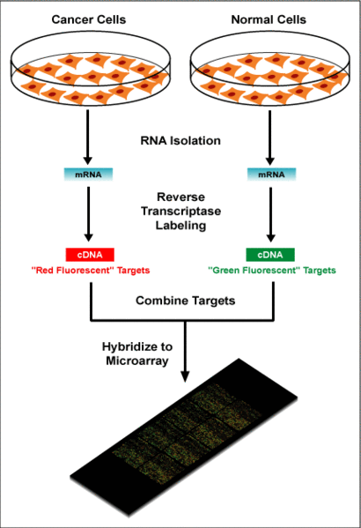
Microarray
Technique that helps to measure the expression levels of thousands of genes simultaneously
Genes from two different samples are taken, labeled with a different fluorescent tags (usually red and green) and hybridized onto a microarray plate.
Colour and intensity gives expression level of each gene on a relative scale.
Notes:
If one of the samples was normal, this expression gives a deviation of the expression levels in some special condition (say cancer) compared to the normal. For example, the expression of a gene X in cancer cells is seen to be double of the normal cells
Added this slide because applying the BBO technique on microarray data without giving any explanation of what it is felt absurd!

Slide 4
The issue
Microarrays generate a lot of complex data.
Number of genes is usually much more than number of samples in microarray gene expression dataset.
Increased difficulty in solving the classification problem by machine learning
Most genes do not contribute to the classification process.
Notes:
Example of complex data: Intensity of fluorescence + exact colour detected (%red and %green gradation)

Slide 5
Possible solution?
Select a small subset of informative genes from the data - gene selection or feature selection
This step acquires extreme importance towards construction of efficient classifiers
This step tackles overfitting by reducing noisy data, reduces computational load and improves the overall classification performance of the learning models.

Slide 6


Gene Selection Algorithms
Wrappers and Filters

Slide 7
Wrappers
Wrappers make use of learning algorithms to estimate the quality or suitability of genes to the modelling problem.
Optimization algorithms in combination with various classifiers fall into this category

Slide 8
Filters
Filters evaluate the genes considering their inherent characteristics without making use of a learning algorithm.
Filters, therefore, give an insight into the properties of the dataset we use.
Algorithms based on statistical tests and mutual information are some examples of filters.

Slide 9
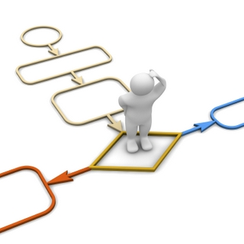
Methodology
BBO-RF and BBO-SVM approaches
Notes:
Since Biogeography background and BBO theory has been covered in previous presentation, max 1 slide should be enough to cover the background of BBO here (just throwing the relevant terms should be enough)?

Slide 10
Biogeography Based Optimization
Study of the distribution of species and ecosystems in geographic space and through geological time.
Habitat Suitability Index (HSI) - Capacity of a habitat to support a selected species
indicates the appropriate species survival index.
Suitability Index Variables (SIVs) - Habitability is related to features such as rainfall, topography, soil quality, temperature, etc.
In general, HSI and number of species in that habitat are directly related.

Slide 11
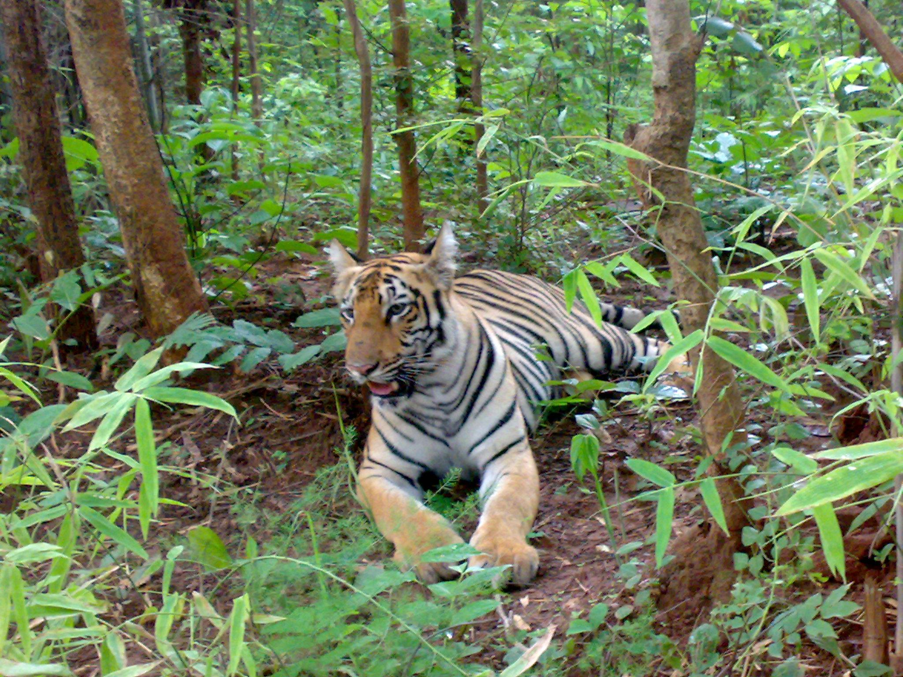
High HSI habitat
High Emigration Rate
Low Immigration Rate
Neighbouring habitats
Emigration
Immigration

Slide 12
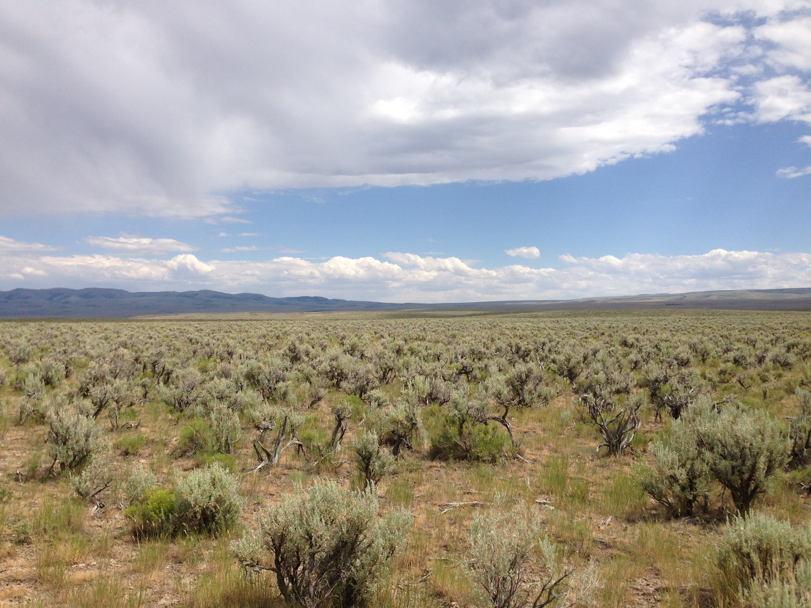
Low HSI habitat
High immigration rate
Low emigration rate
Neighbouring habitats
Immigration
Emigration

Slide 13
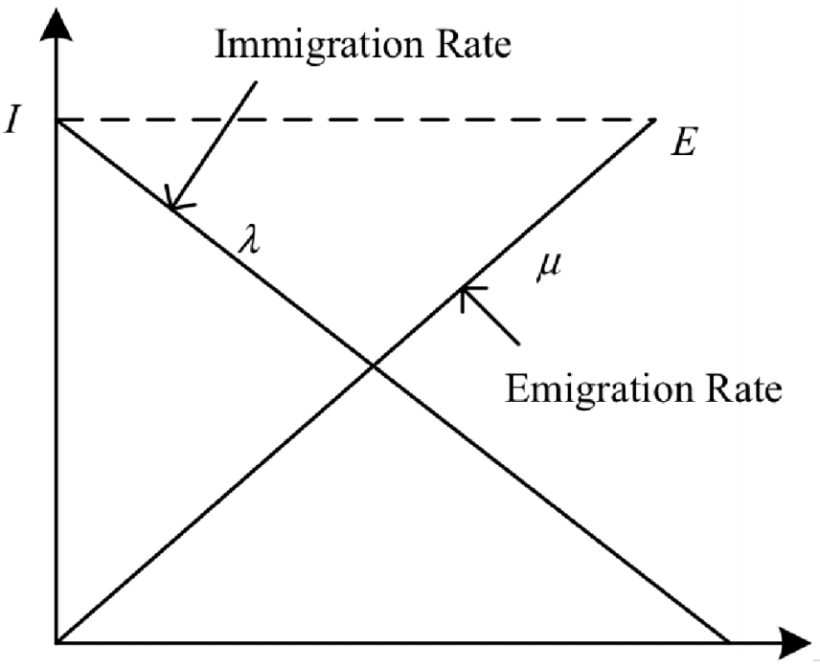
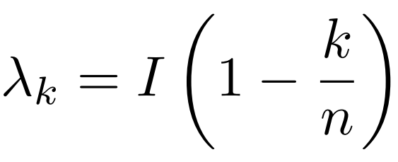
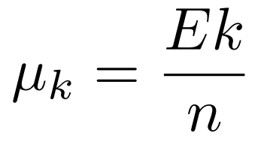
Simple Linear Mathematical Model
E and I are the maximum emigration and immigration rates, both typically set to 1.
The individual immigration and emigration rates (λ and µ) are calculated by:

Slide 14
BBO Gene Selection Algorithm
A gene (identified by gene number) is treated as an SIV for a Habitat.
Each habitat has m SIVs.
We ensure that a gene is not duplicated within a single subset of genes (habitat).
The subset sizes (m) can be set during each run of the BBO algorithm.
The ecosystem then has habitats all with the same no. of SIVs.

Slide 15
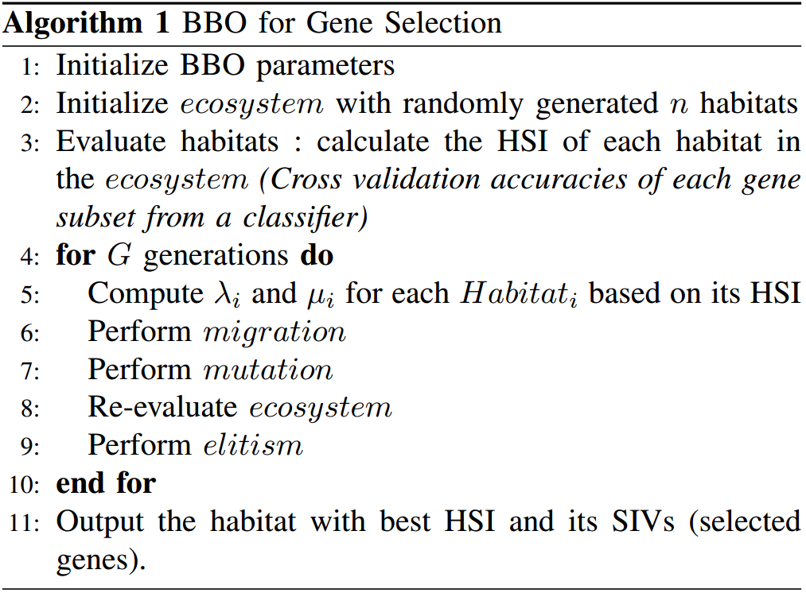
BBO Gene Selection Algorithm
λ -> immigration rate
µ -> emigration rate
Elitism - ensures that the best solutions obtained until a particular generation don’t get corrupted.

Slide 16
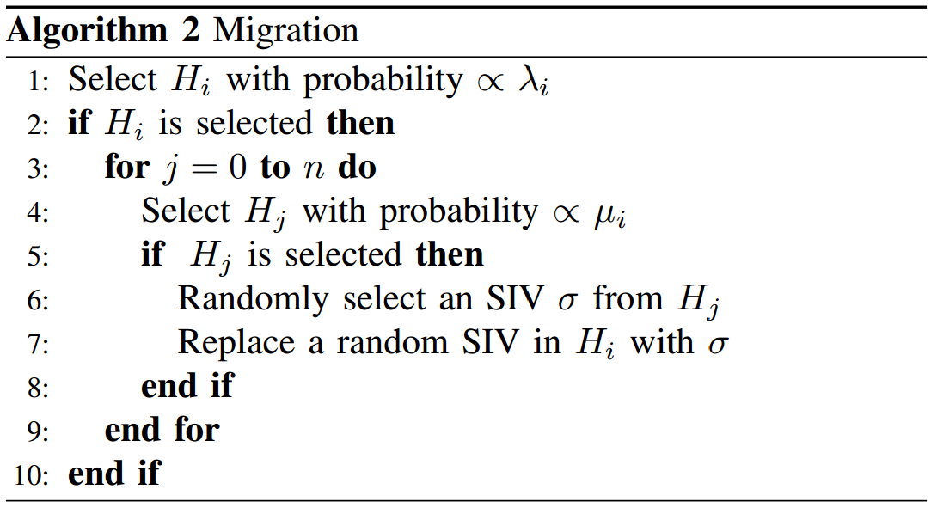
Migration
The migration procedure of the original BBO algorithm is retained.

Slide 17
Mutation with IG Based Gene Ranking
Information Gain heuristics are used as the additional information during mutation.
Information Gain of a gene - Stores the ‘information content’ of a gene with respect to the problem under consideration.
Partition the informative and non-informative genes.
Exploration or Exploitation
In mutation, the algorithm either randomly explores newer genes or exploits from the available set of genes with non-zero IG values.

Slide 18
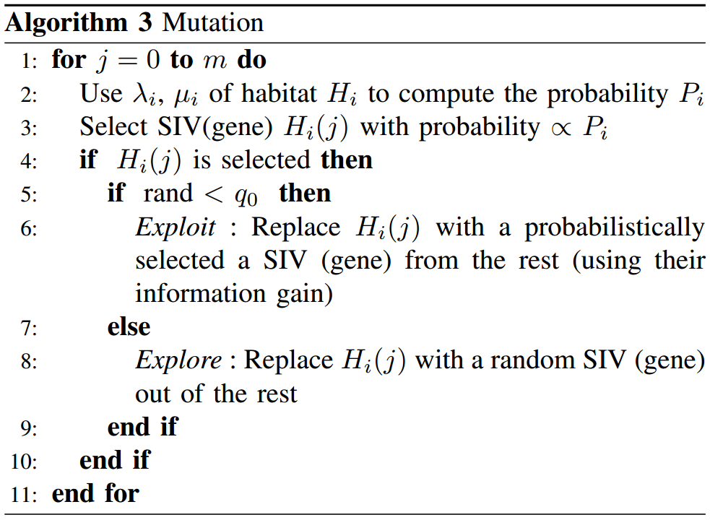
Mutation
q₀ -> User defined exploration probability

Slide 19
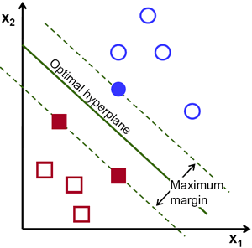
Support Vector Machine
Employs a max margin linear hyperplane for binary linear classification problems.
For non-linearly separable problems, it firstly transforms the data into higher dimensional feature.
SVM with recursive feature elimination (RFE) for gene selection has shown high accuracy levels.

Slide 20

Random Forest
Ensemble of randomly constructed independent decision trees.
Separate test data is not required for checking the overall accuracy of the forest.
A majority vote is taken to decide on the class label for each case.

Slide 21

Discussion and Results

Slide 22
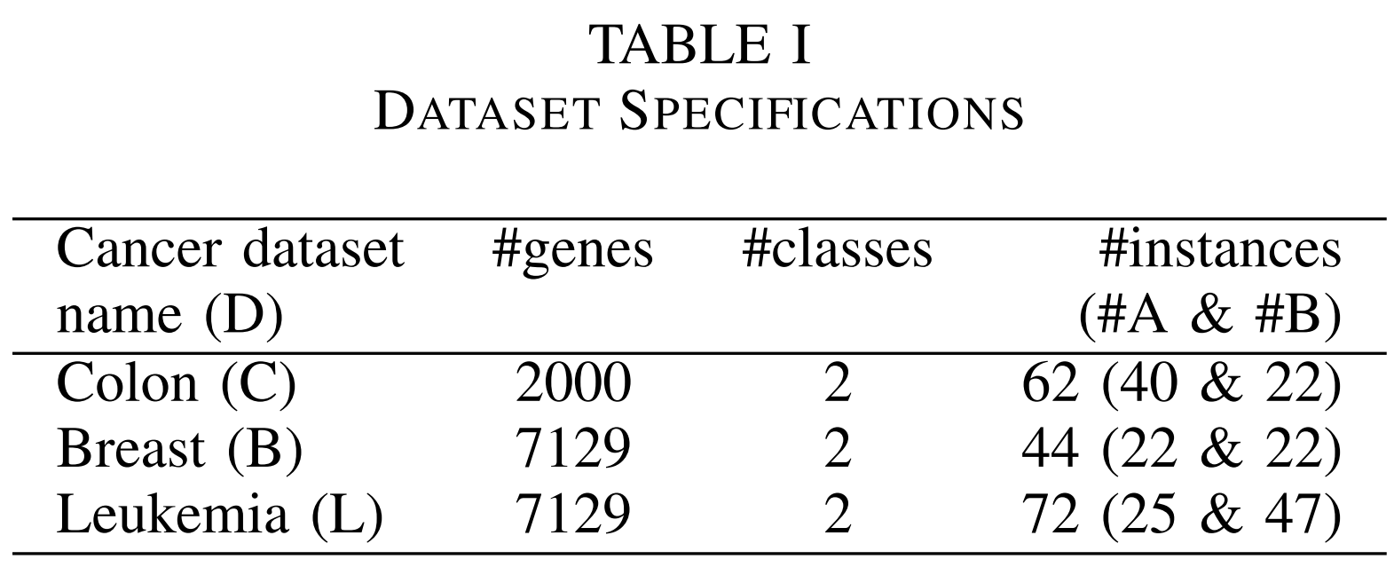
DATASETS
3 datasets used:
Kent Ridge Biomedical dataset repository: The Colon Cancer dataset. 62 instances representing cell samples taken from colon cancer patients.
DUKE Breast Cancer SPORE frozen tissue bank: The breast cancer dataset. 44 samples.
Kent Ridge Biomedical
dataset repository:
Leukemia dataset.
72 samples.

Slide 23
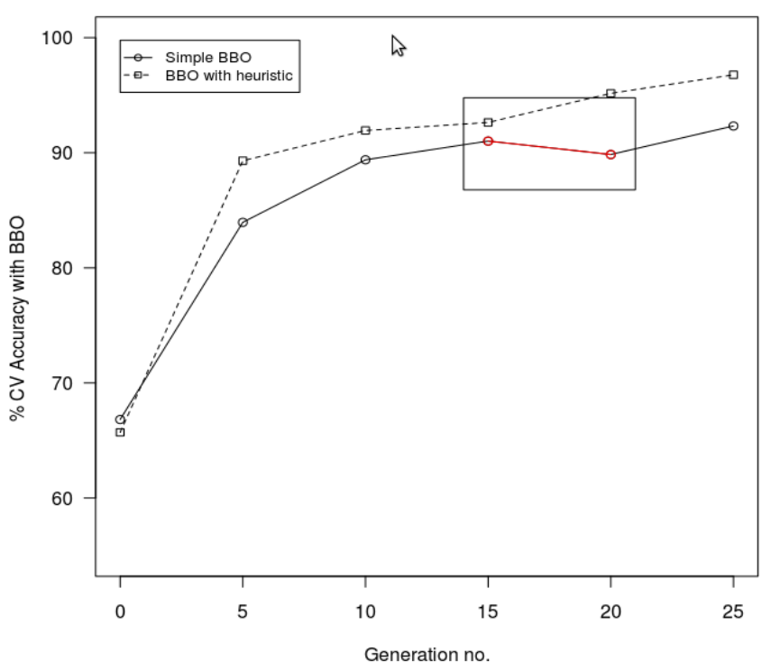
RESULTS
BBO used with and without heuristics (Information Gain of Gene)
Cross Validation with SVM and
Random Forests.
Better performance than other EA.
Population average in BBO with
Information gain heuristics
converged to higher accuracy in
lesser generations as compared to
simple BBO.

Slide 24
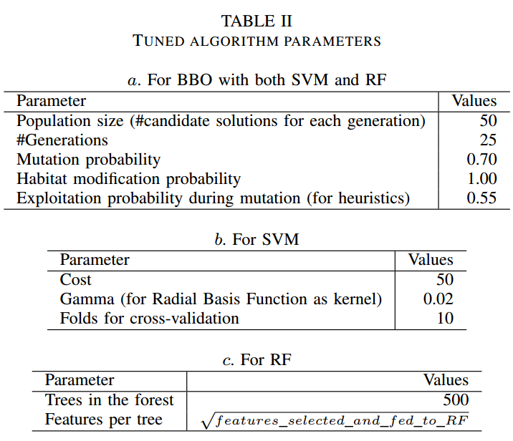

Slide 25
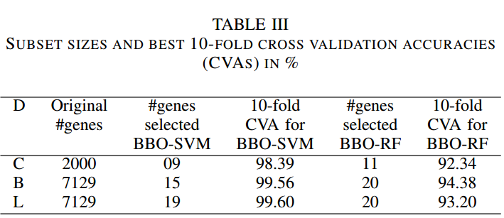
BBO with SVM has outperformed BBO with Random Forests.
BBO-SVM and BBO-RF have better accuracies compared to the previously best performing algorithms namely SVMRFERG ,
Fisher-RG-SVMRFE, ACO-AM
(Ant Colony Optimization–
Ant Miner) and ACO-RF and
other algorithms for all 3
datasets.

Slide 26

Conclusion and Future Work

Slide 27
The hybrid BBO-SVM and BBO-RF techniques have shown consistently good results when compared against the highest accuracies with accuracies as high as 99.60%
BBO-SVM better than BBO-RF.
A significant speedup in the algorithm may be achieved by parallel implementations where the classification accuracies for individual candidate solutions may be computed in parallel.
Simple to implement, robust and flexible since we can have various possible alternatives as suited to the problem and domain constraints.

Slide 28
Being very flexible our hybrid methods spur many possibilities.
Some problem dependent and some from the implementation perspective.
For e.g. each habitat could have arbitrary number of SIVs and may differ from other habitats in the ecosystem.

Slide 29
THANK YOU

